Slide 1

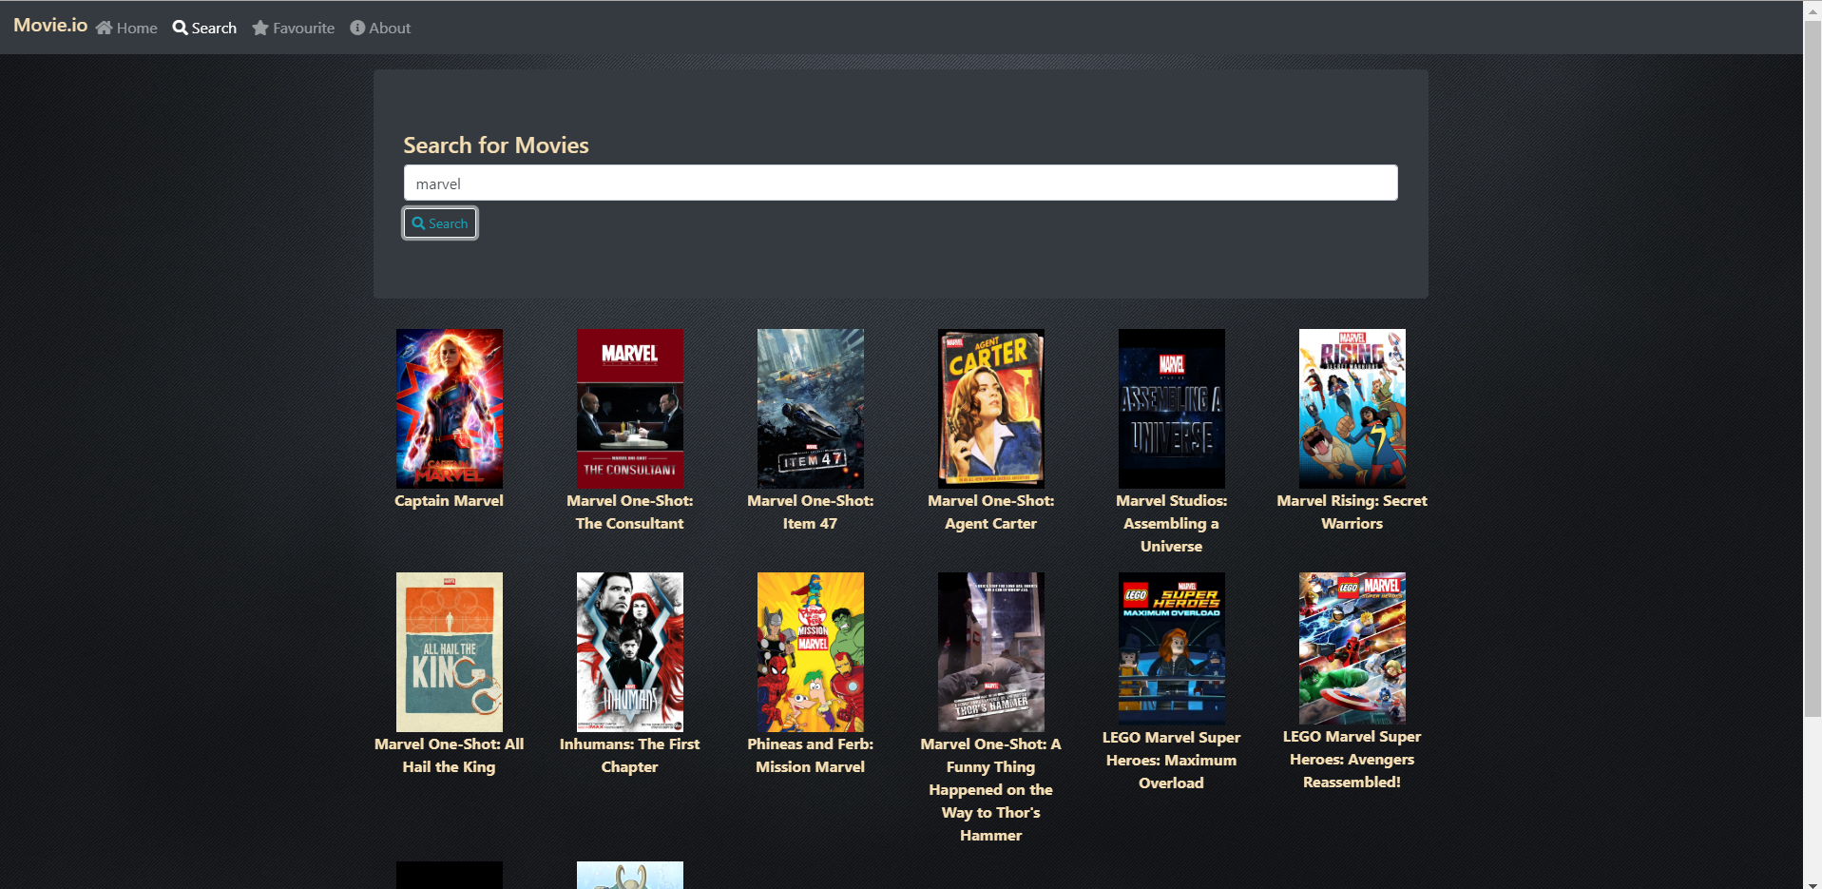

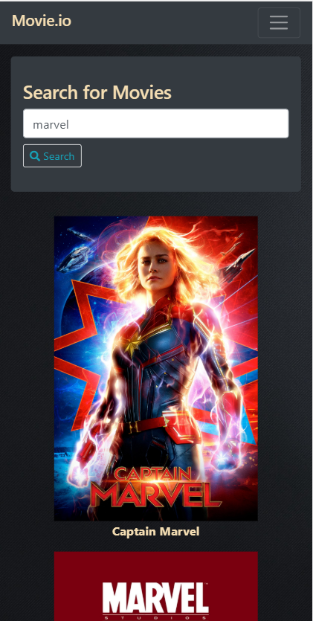
Project
Movie.io
George Kopti

Slide 2
Outline
An Online Database Related to Movies
Keep Up With Latest Movie Trends
Libraries and Platforms
APIs
Device native APIs
Similar Products : IMDb

Slide 3
Movie.io
Bingeing is the new way to consume content.
Movie.io is your one-stop app for all your movie related entertainment needs.
Access a huge database of movies.
Easy to use UI that displays relevant information to the user.
Save your favourite movies for later.

Slide 4



Libraries and Platforms Used
Bootstrap was used to make the website responsive, jquery was used to manipulate the DOM and all was done on the cordova platform

Slide 5


APIs Used
Great and free source to get movies and information about movies
Used to get the location of the nearest theatre around the block

Slide 6


Device native APIs Used
Geolocation to get the nearest theatres that are nearby
Saving the users Favourite movies to a webSQL database

Slide 7
Why Movie.io
Movie.io helps people keep track of movies they would like to watch.
Be up to date about any movie that comes out.
Helps people find the nearest theatres nearby.
Helps people search for movies.
Check the rating and the description of any movie.

Slide 8
References
https://developers.themoviedb.org/3/getting-started/introduction
https://developers.google.com/maps/documentation/javascript/tutorial

Slide 9
Thank You
Any Questions?

